Slide 1
Secure Web Programming
Lecture 10 Human computer interaction/interface
Amanda.Lunt@utas.edu.au
Soonja.Yeom@utas.edu.au

Slide 2
Topics
Secure Web Programming
Week13
Review
Basic Web Programming
Web Security
Adv. Web Programming
Fundamentals – protocol, CS model, etc.
HTTP Protocols, Storage
Advanced Web Applications
Human Computer Interaction with Web Page Design
Security Issues and Technologies
Session management
Client-side Scripting Language and Document Object Model
Secure Programming and Users
Common Gateway Interface
Server-side Scripting Language and Privilege configuration
Encryption and Authentication
Advanced Security Issues

Slide 3
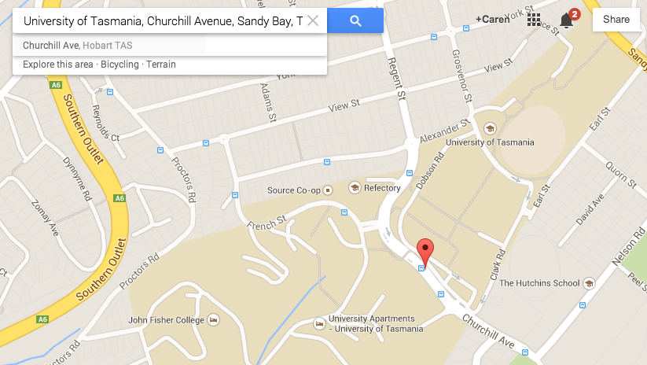
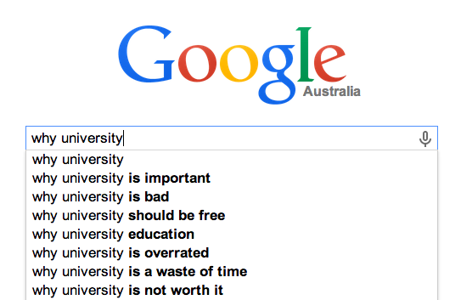
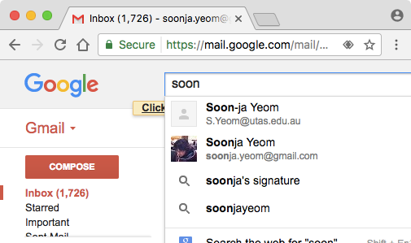
Review: Web Applications with AJAX
Google search - query suggestion
Google Map
Gmail

Slide 4
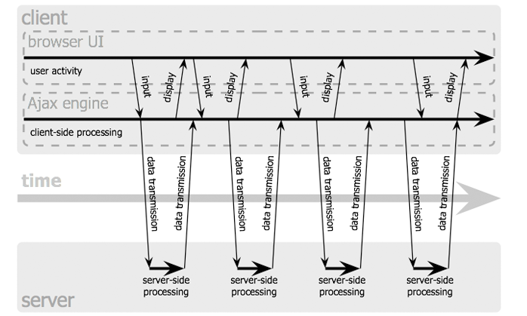
Review: Asynchronous communication

Slide 5



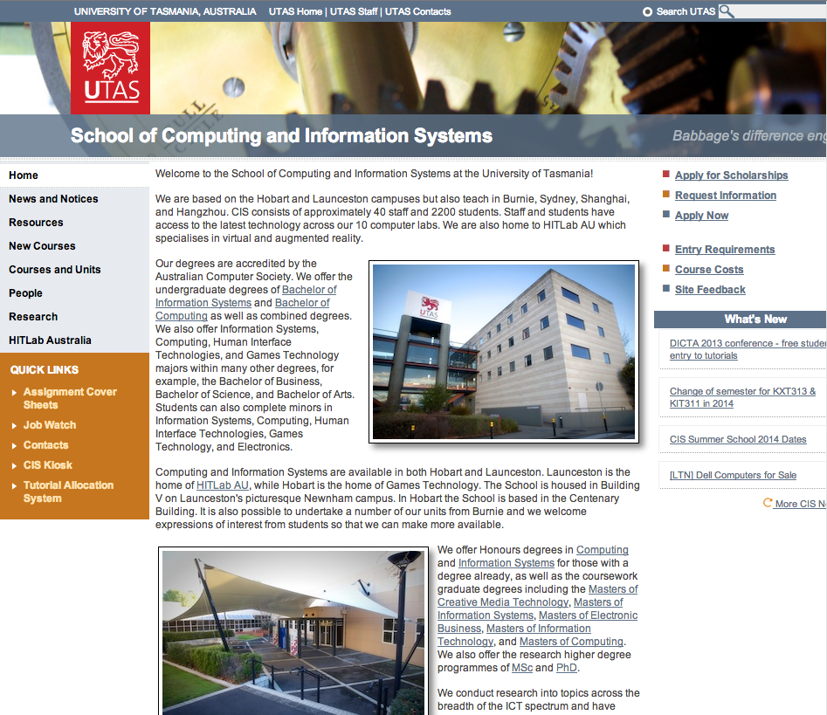
Review: Classic Model vs AJAX Model
Classic Web Application Model
AJAX Web Application Model
Request message
Query
Database
Response message (HTML+CSS+JavaScript…)
Data
Client computer
Server
User Interface
JavaScript call
AJAX Engine
Request message
Query
Database
Response (HTML + CSS Data…)
Response message (Data – plain text, XML, or Json Data)
Data
Server
Client computer

Slide 6
Review: AJAX “toolkit”
A combination of technologies are needed:
a server-side language (eg PHP) used to produce the responses
valid markup (eg XHTML, HTML)
DOM scripting (to modify parts of a page when needed)
HttpRequest object - to send the messages to the server
A means of data transfer (datatype can be plain text or XML or JSON…)

Slide 7
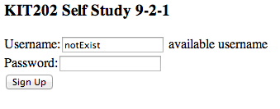
Review: Data Transfer – type 1: plain text
A plain text string
The plain text type return the data with no processing
Example using jquery
$.ajax({
url: ”checker.php",
datatype: 'text',
data: {username: username}
})
.done(function(data) {
$("#output").html(data);
});
$.get(
url: ”checker.php”,
data: {username: username})
.done(function(data) {
$("#output").html(data);
});
same
[example output in the self-study 9_2_1.html]
NOTE: checker.php contains the SQL query that checks the whether username exists or not

Slide 8
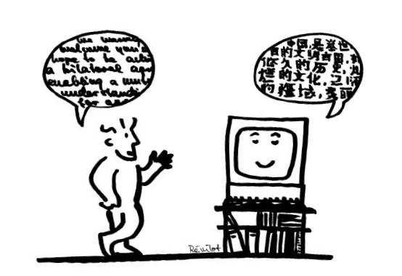
Image source : www.interaction-design.org

Slide 9
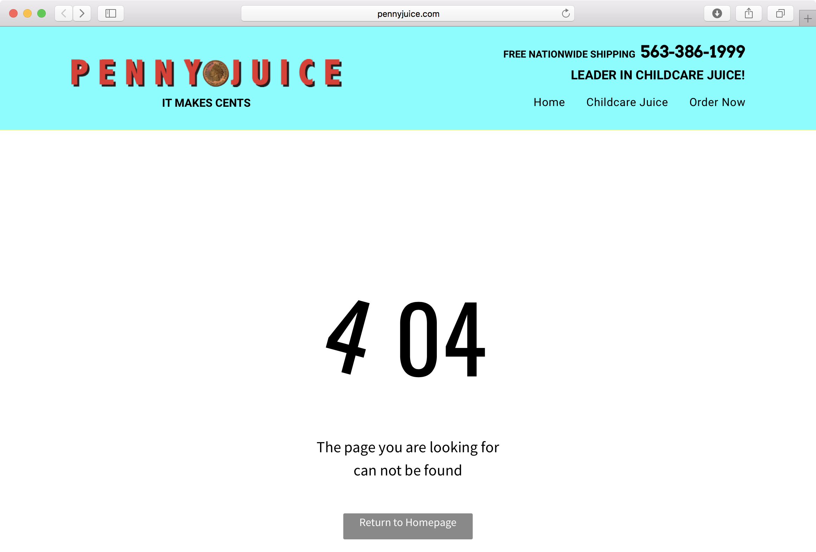
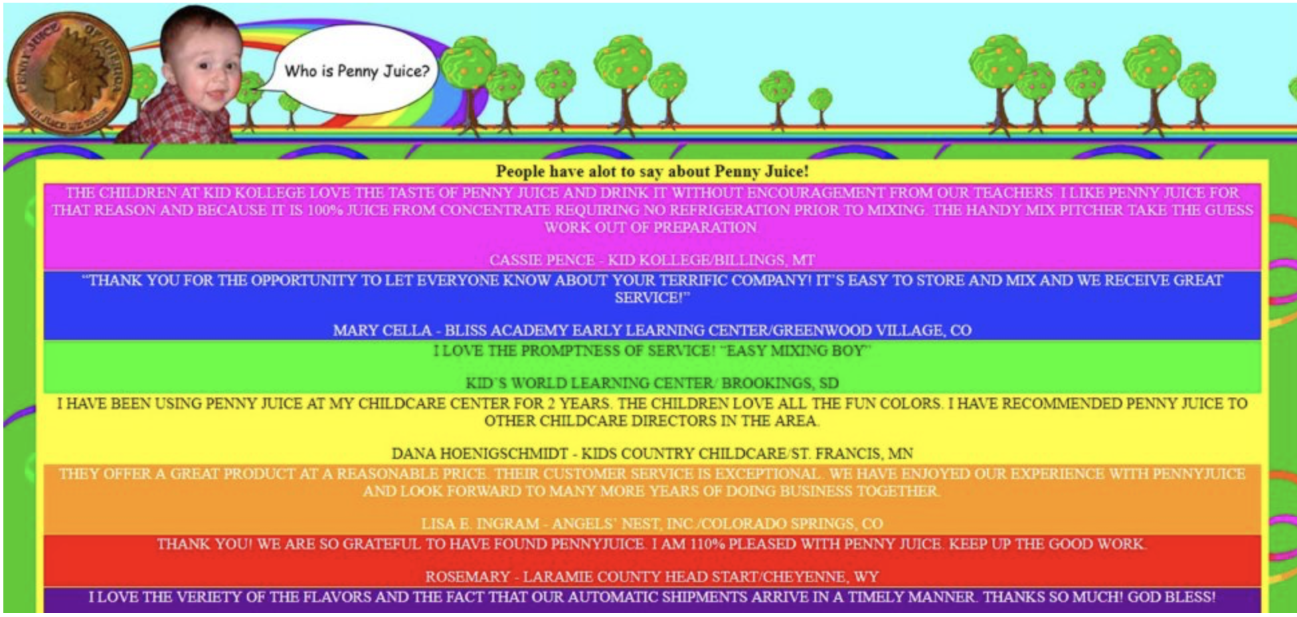
Examples
http://www.pennyjuice.com/htmlversion/whoispj.htm

Slide 10
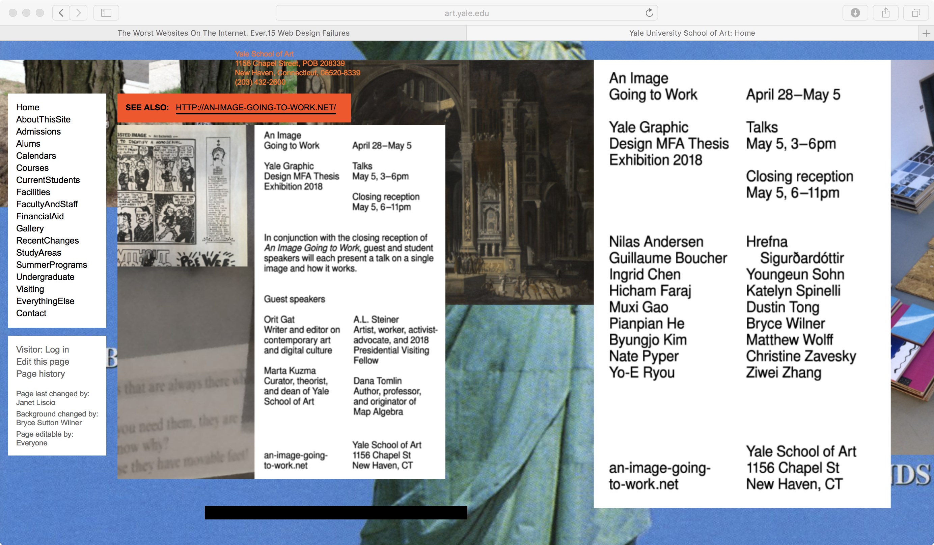
http://art.yale.edu

Slide 11
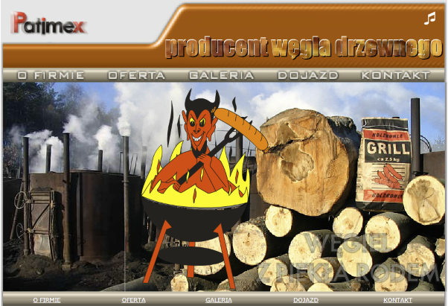
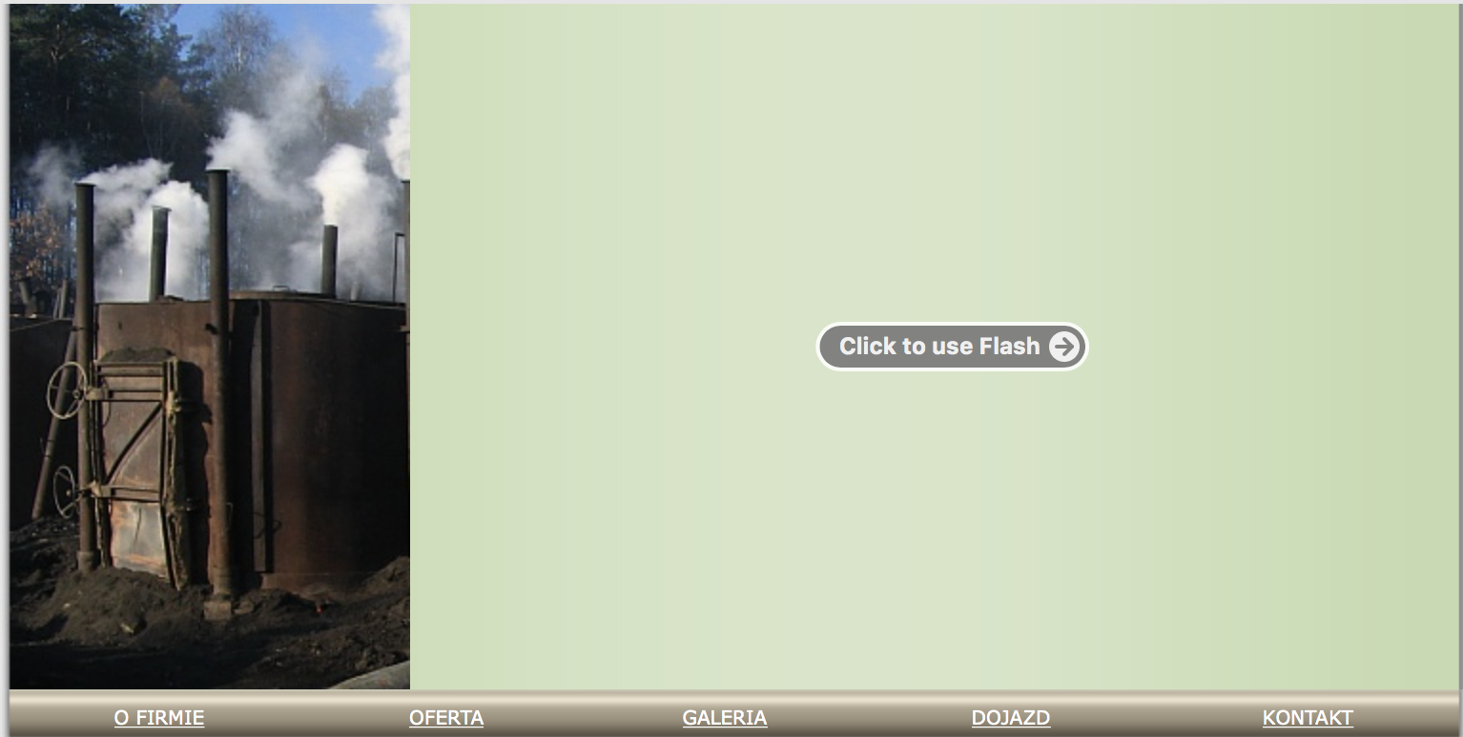

Slide 12
Website Design
What to consider?
Content
Target audience
Organising (Navigation, Site structure)
Visual appearance
Usability

Slide 13
Web Design and HCI
User centered design
Consistency (Aesthetics, Anticipation, Learnability)
Readability
Colour : a vital element but use it with caution
Many more…

Slide 14
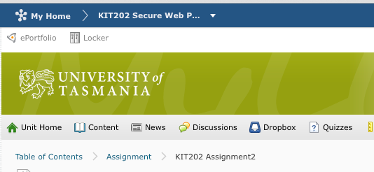
Where have I been?
14
Breadcrumbs
E.g. My Home … KIT202 … Assignment

Slide 15
Where am I now?
Your navigation needs to identify which area the user is currently in
Each page must be useful on its own. People might be linked directly to it, might bookmark it, or even download it

Slide 16
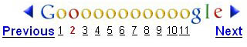
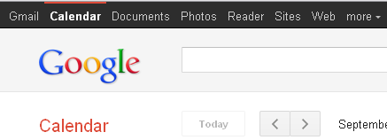
Where am I now?
16
Breadcrumbs again:
. My Home … KIT202 … Assignment

Slide 17
Where should I go next?
The most obvious part of navigation: how do I find what I am looking for?
This is actually a two-part question:
What am I looking for?
How do I get there?
Structure for navigation

Slide 18
Hierarchical Structure
Homepage
Deep hierarchy
Requires many clicks to get to content
A
B
C
D
E
F
G
H

Slide 19
Hierarchical Structure
Broad hierarchy
Fewer clicks to find content, but more options to consider
Homepage
A
B
C
D
E
F
G
H

Slide 20
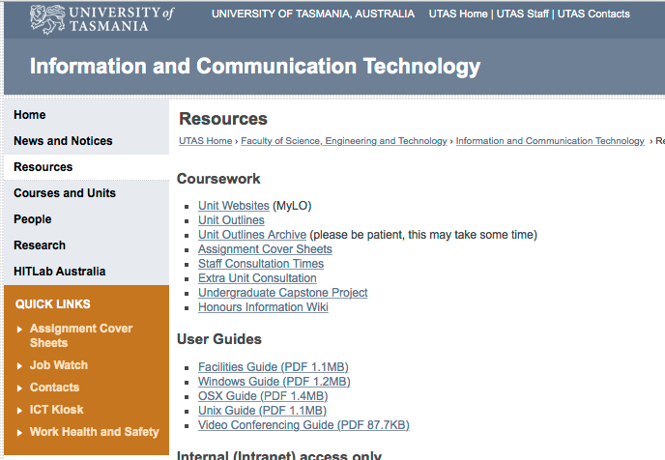
Hierarchical Structure

Slide 21
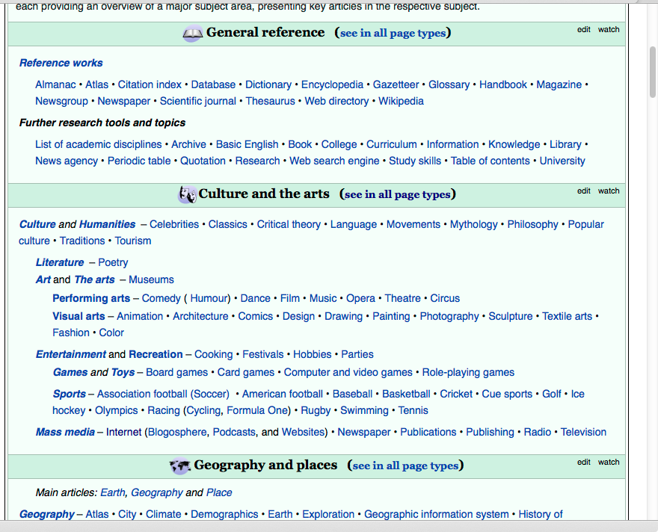
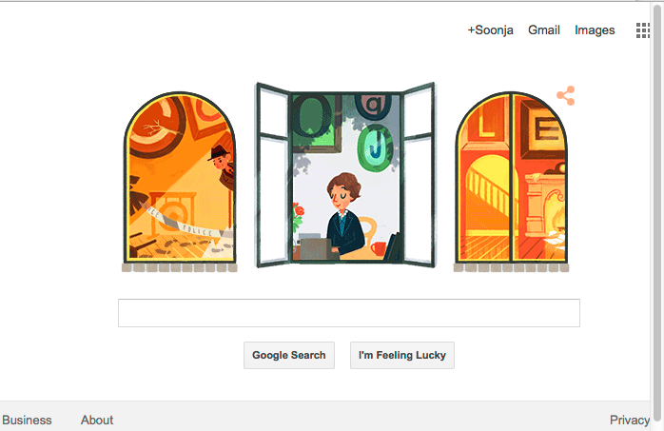
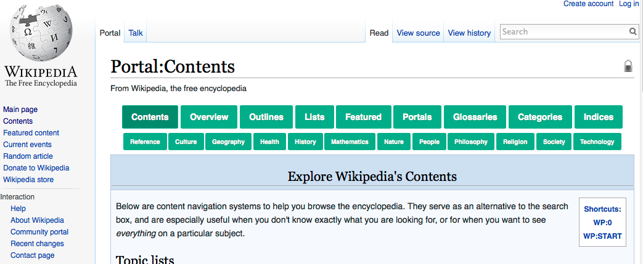
Database Structure
21
The most famous example:

Slide 22
Database Structure
Pages are accessed directly and individually, via various search methods, e.g.
A search form
Alphabetic listing
Time-based listing
The user types or selects what they are looking for, and are given that content
Ideally, everything can be found in one click

Slide 23
Database Structure
This structure is most commonly implemented through search forms
However the searching functionality may be left up to the user
Ctrl+F/ Command+F
Manual scrolling and scanning
can be frustrating:
If you don’t know the right search terms, you may not be able to tell whether the content even exists
Imprecise search results or long listings can easily result in a tl;dr attitude

Slide 24
Hypertext Structure
Content is connected and accessed through hyperlinks
This is a much more ad-hoc structure than either a hierarchy or database
Clearly not an effective structural choice by itself
Works well in combination with other options

Slide 25
Hypertext Structure
Homepage
Structural links can be added anywhere
A
B
Ad Hoc Link
C
D
Ad Hoc Link
E
F
G
H

Slide 26
Hypertext Structure
Provides flexibility to other designs
Reduces number of clicks required to access important or commonly required pages
Can become confusing very quickly
How did I get here? Where am I in the site?

Slide 27
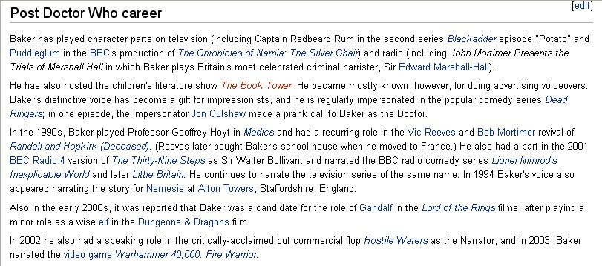
Hypertext Structure

Slide 28
Website Organisation
Sites rarely use just one structure
Instead, most sites have a combination of at least two, possibly all three
Intentional redundancy

Slide 29
Navigation Tools
Effective use of
Navigation Bar
Menus
Cascading
Breadcrumbs

Slide 30
Trend in 2018
Multi device, responsive design
Web animation
More vivid colours

Slide 31
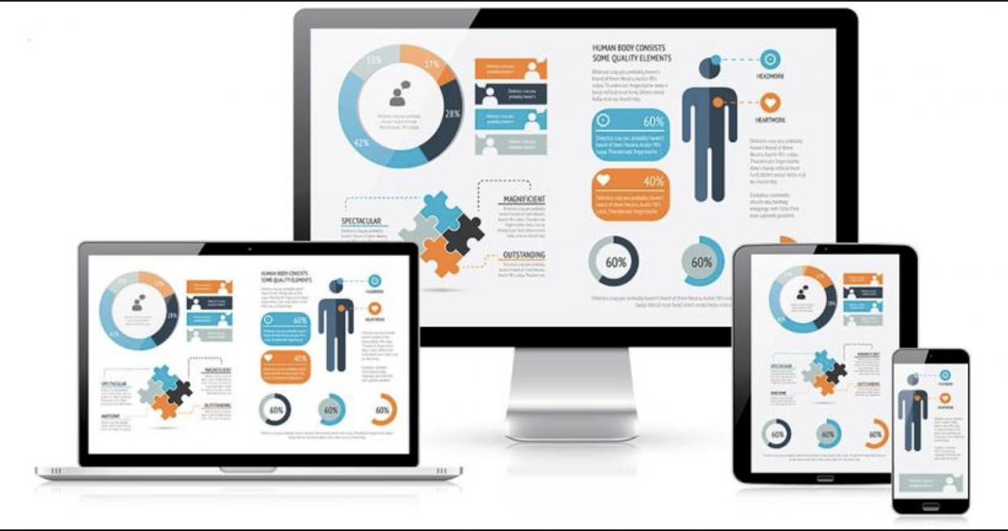
Responsive Web Design

Slide 32
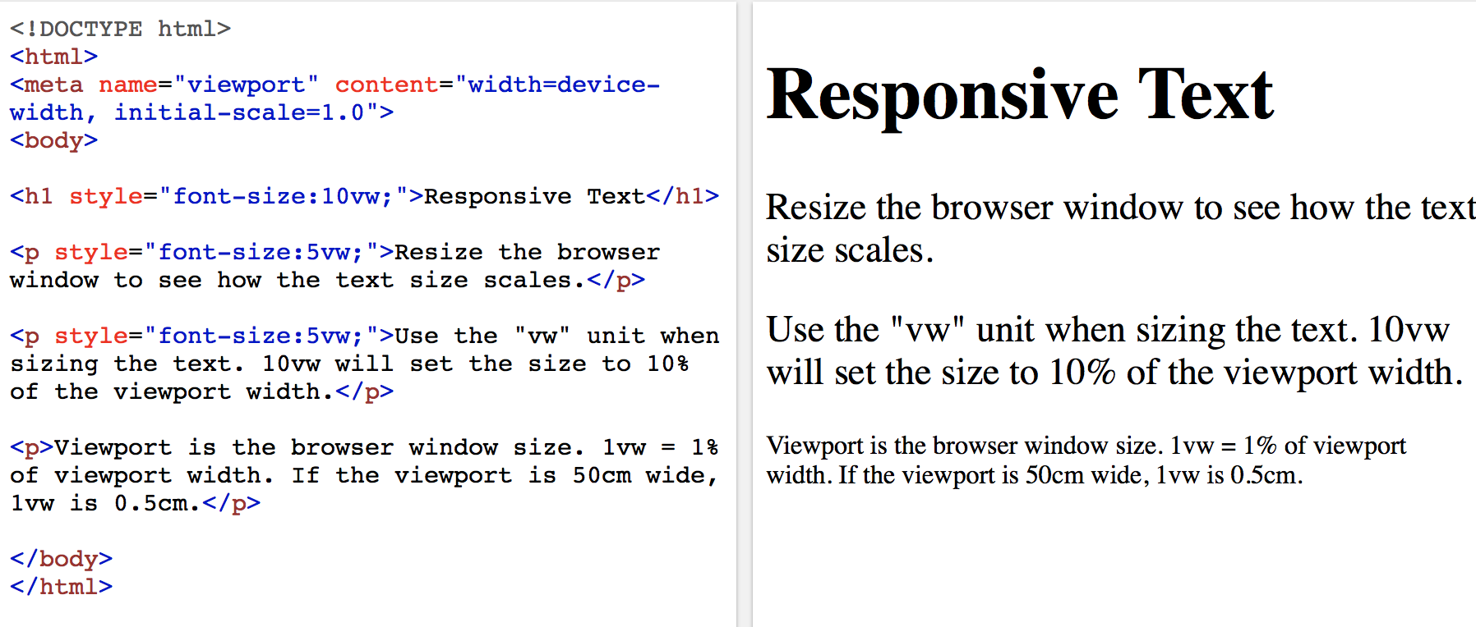
Responsive in HTML
W3schools.com

Slide 33

Different media types
https://www.creativebloq.com/features/web-design-trends

Slide 34
To sum
Principles to remember
Consistency
Target audience
Readability
Plan and design your screen, functionality, navigation

Slide 35
Examples

Slide 37
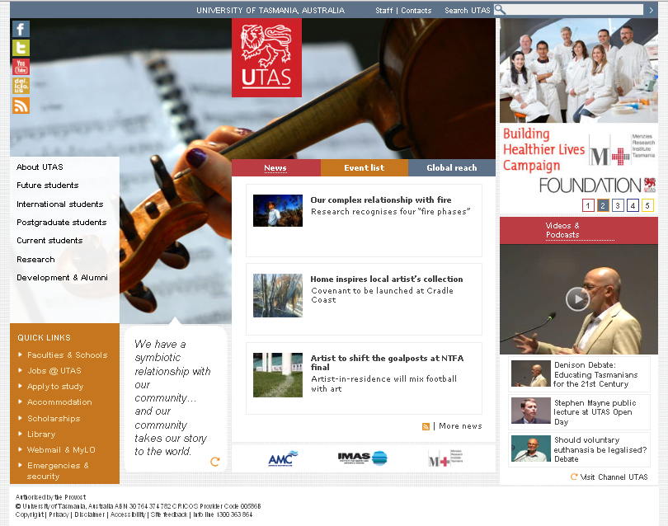
Year 2015

Slide 38
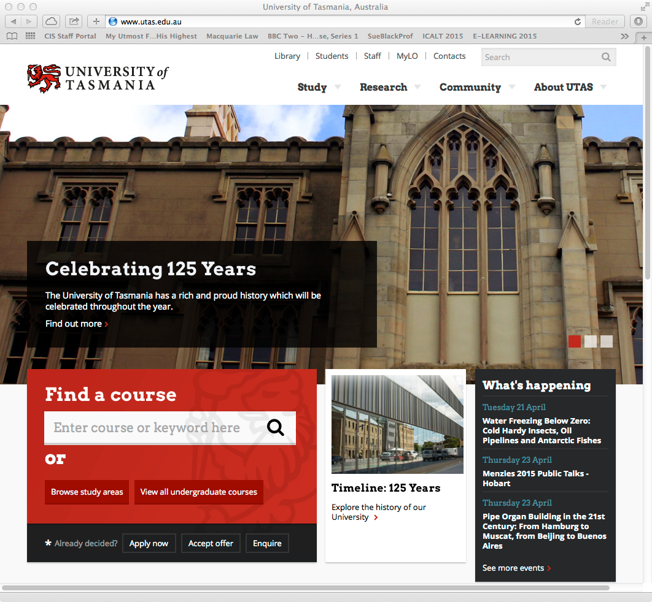

Slide 39
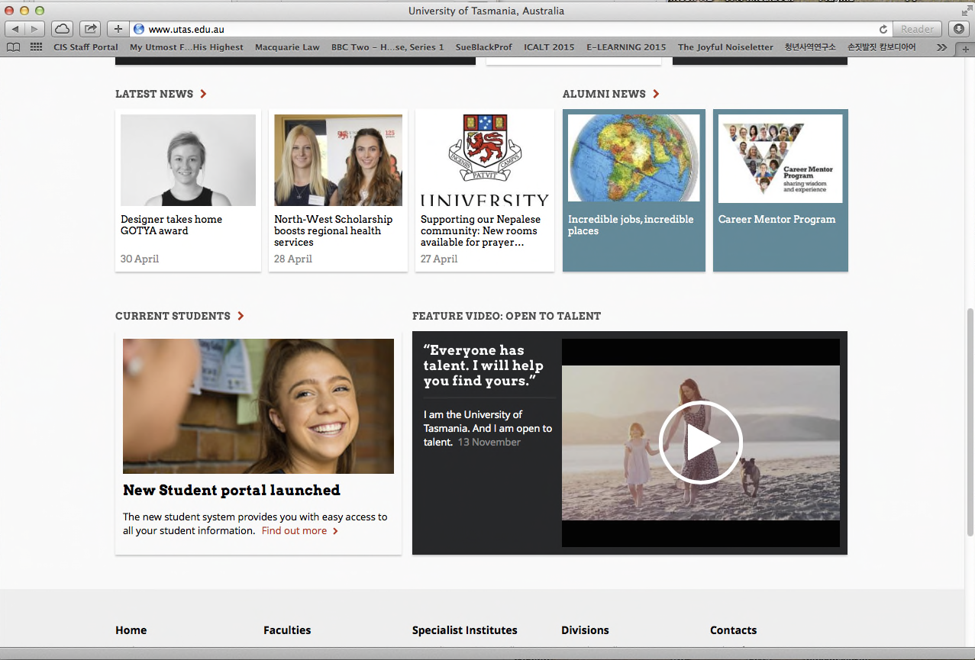

Slide 40
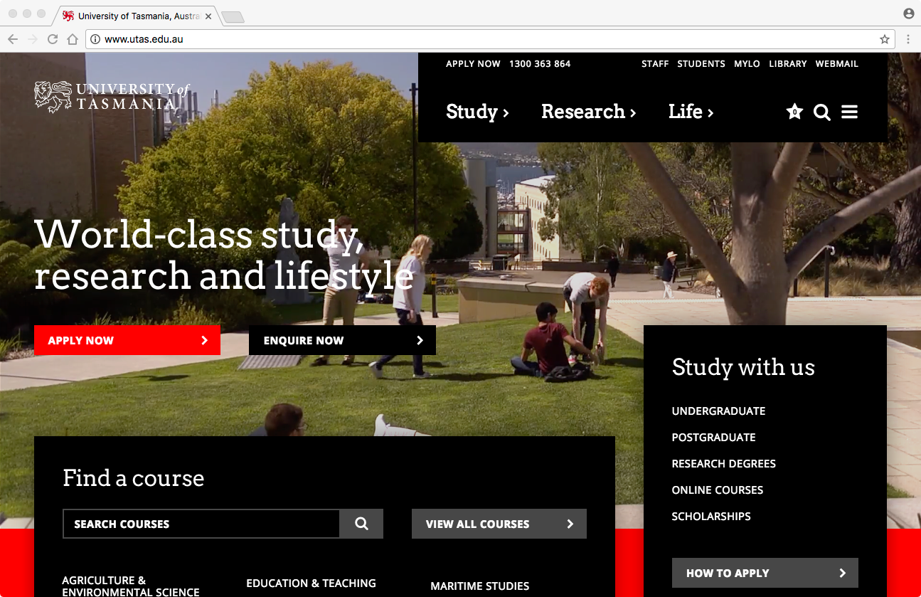
2017

Slide 41

2018

Slide 42

2018

Slide 43
More Examples

Slide 44
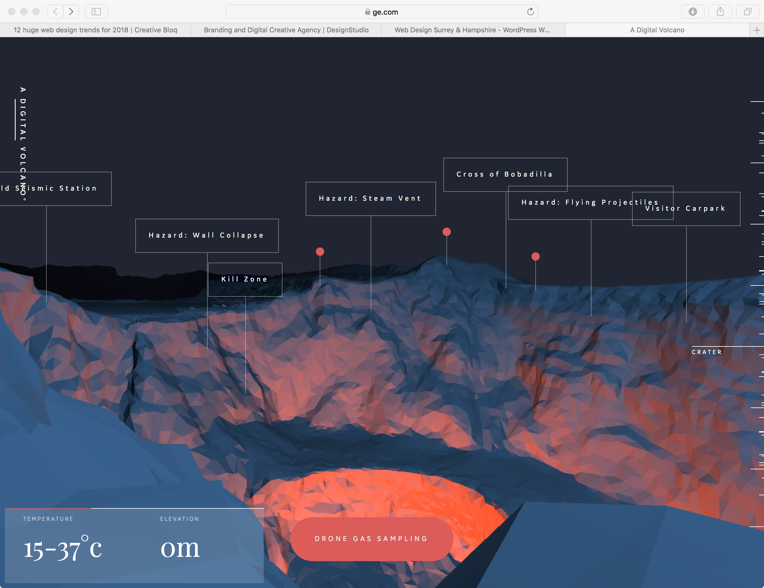
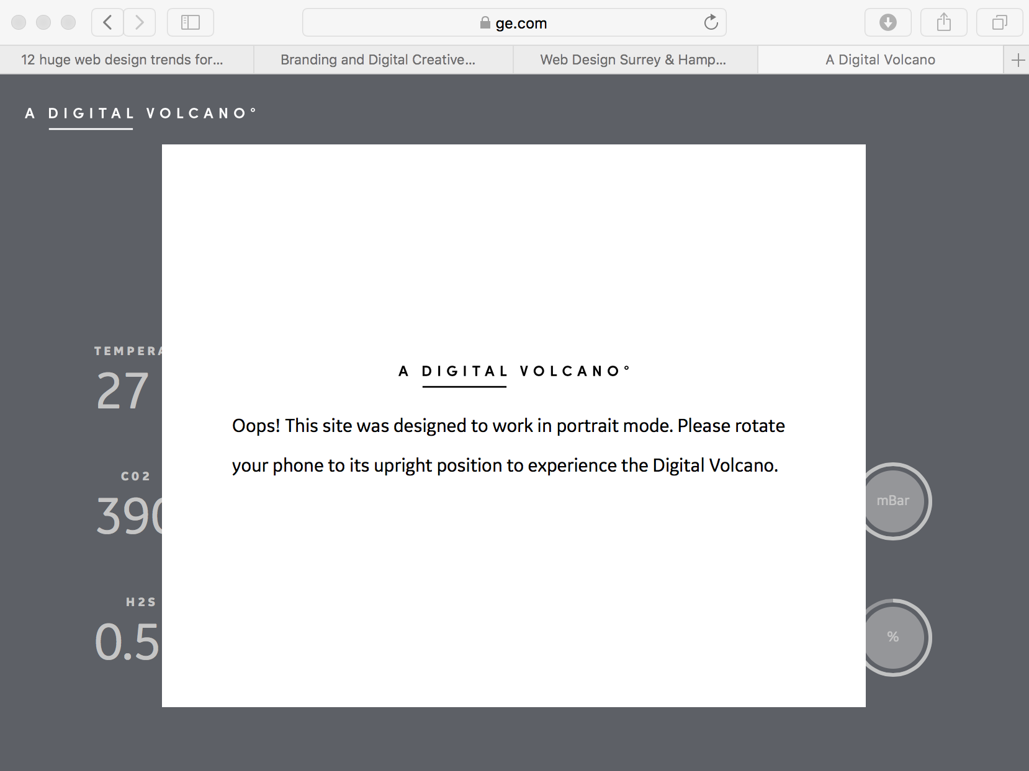
Example of interface
https://www.ge.com/digitalvolcano/

Slide 45
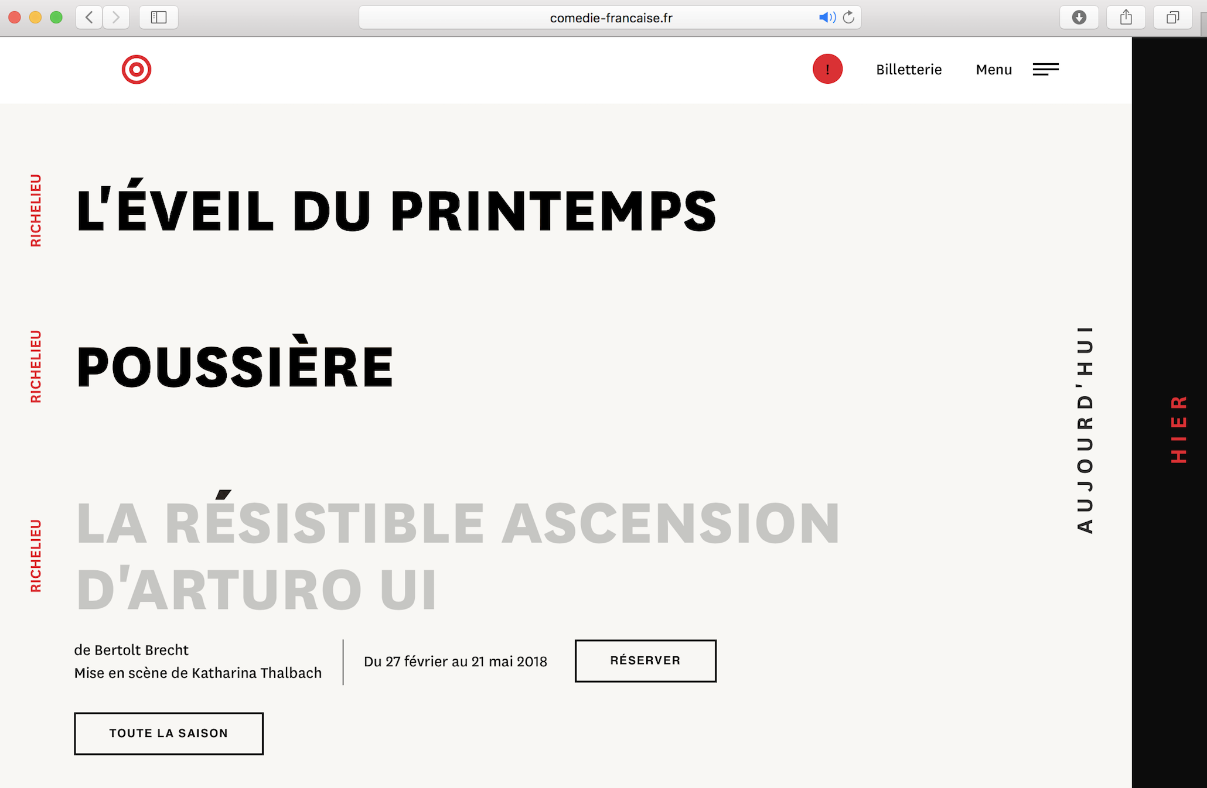
Another example – text hover
https://www.comedie-francaise.fr

Slide 46
World Best Top 10 (2018)
World best top 10 Corporate web sites (Forbes)
GSK 216 (out of 280) owns Pfizer.
Bayer 213
BP 213
Nestle 213
Eni 212
Unilever 209
Siemens 206
Roche 205
Shell 205
BASF 202

Slide 47
Accessibility
Accessible web site

Slide 48
Accessibility
What is an accessible web site?
can be navigated and read by everyone,
regardless of location, experience, or the type of computer technology used
people with disabilities, because this group are most likely to be disadvantaged if the principles of accessible web design are not implemented
Failure to follow these principles can make it difficult or impossible for people with disabilities to access web pages.
http://www.hreoc.gov.au/disability_rights/standards/www_3/www_3.html (Australian Human Rights Commission)

Slide 49
Accessibility
Personal diversity
A page is accessible :
The content is perceivable by every user
Any interface components are operable by every user
The content and controls are understandable by every user
The content is robust enough for current and future technologies
[W3C accessibility initiative]

Slide 50
Accessibility
Legality
It is not illegal to create a web site which is not accessible
But it is illegal to discriminate against somebody
Official website of 2000 Sydney Olympic failed a court case (Disability Discrimination Act 1992)
The Australian Human Rights and Equal Opportunity Commission (HREOC) Disability Rights Unit
Disability Discrimination Act (DDA) 1992

Slide 51
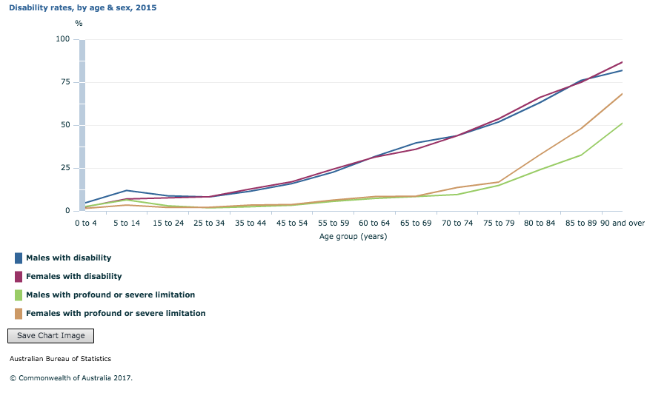
Disable population in Australia
ABS accessed in May 2018

Slide 52
Disable population in Australia
Major types of disability:
Physical (3.4 million, 15%)
Vision (357,000)
Blindness, low vision, colour blindness
Unable to view video
Hearing (1 in 6)
Cognitive (668,100)
Complex language or images
Navigation confusion
Literacy
Australian Network on Disability
20% had a disability (4 million Australians)
April 2015

Slide 53
Disable population in Australia
Living with disability (18.3% or 4.3 million people)
Older populations active ( 49.2%)
Almost one in 12 Australians with disability (281,100 people or 8.6%) reported they had experienced discrimination or unfair treatment because of their disability.
Young people with disability (aged 15 to 24 years) were more likely to report the experience of discrimination (20.5%) than those aged 65 years and over (2.1%).
Over one-third (35.1%) of women and over one-quarter (28.1%) of men aged 15 years and over had avoided situations because of their disability.
Australian Bureau of Statistics (ABS), Survey of Disability, Ageing and Carers 2015. viewed 30 April 2018

Slide 54
Assistive Technology
Screen readers (e.g JAWS for Windows, Voiceover for Mac)
Screen magnification software (e.g handheld magnifier over it)
Text reader (synthesized voice)
Speech input software (e.g Dragon Naturally Speaking)
Alternative input devices
Head pointers
Motion tracking or eye tracking
Single switch entry devices (e.g. on-screen keyboard with a cursor)

Slide 55
Who benefits?
People with
disabilities
slow connections
People with old equipment
People with “non-standard” equipment or restricted access environments
People with temporary impairments or who are coping with environmental distractions, and
Older people and new users

Slide 56
Vision-impaired users
Popular screen reader is JAWS (Job Access With Speech)
Transcript
"Page has five links. Graphic trans dot gif. Graphic image underline one dot gif. Welcome to Fungi Online an online resource devoted to the science of mycology and the hobby of mushrooming. When people think of fungi they automatically think of mushrooms and toadstools but the world of fungi is much broader than that. In fact there are several thousands different varieties of fungi, from the giant Boletes of the North American redwoods to the thousands of varieties of microscopic fungus found all over the world. And there are just as many fungi lovers all around the world too. At the recent Miami world conference over three hundred fifty fungi fans got together to celebrate the world of fungi. link graphic images slash image underline two. Click the image to hear d r wilsons welcome message to the maa. graphic trans dot gif. graphic trans dot gif. Graphic image underline three dot j p g. a beautiful specimen of Hylecie Morosis growing in the Peruvian rainforest site contents. Click the fungi icons below colon link graphic images slash icon."

Slide 57
Screen reader accessibility
JAWS reads the HTML code as it is written, including the filename of the image:
<img src=“images/image_3.jpg”>

Slide 58
Using an ALT tag
<img src=“images/image_3.jpg” alt=“Photograph showing the bright pink inverted caps of Hylecie Morosis growing on a dead twig”>

Slide 59
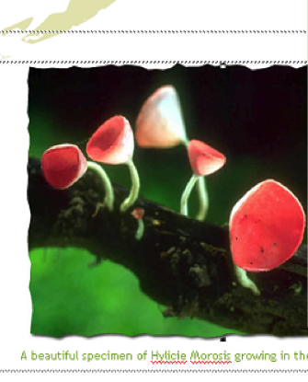
Original Colour Design
WARNING : These fungi can kill!!

Slide 60
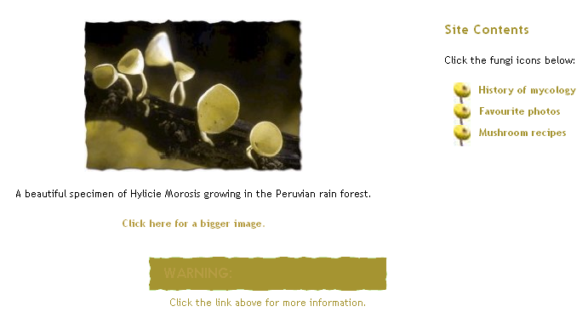
Appearance if colour blind

Slide 61

Using appropriate colours
Avoid certain combinations
Animation effect impossible to read by people with dyslexia
A better alternative would be

Slide 62
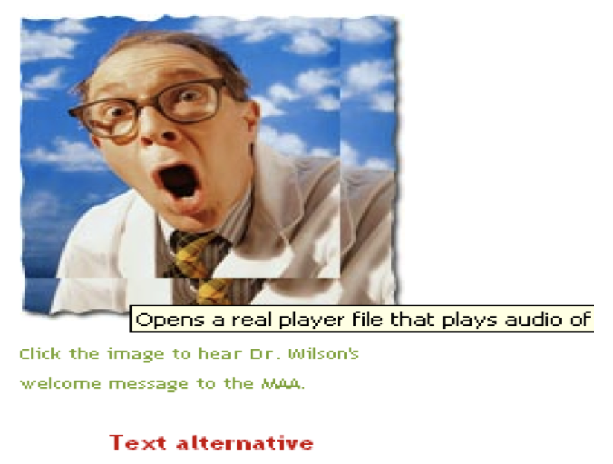
Hearing difficulties
Include transcript or text alternative to audio
Text alternative allows user to print the transcript

Slide 63
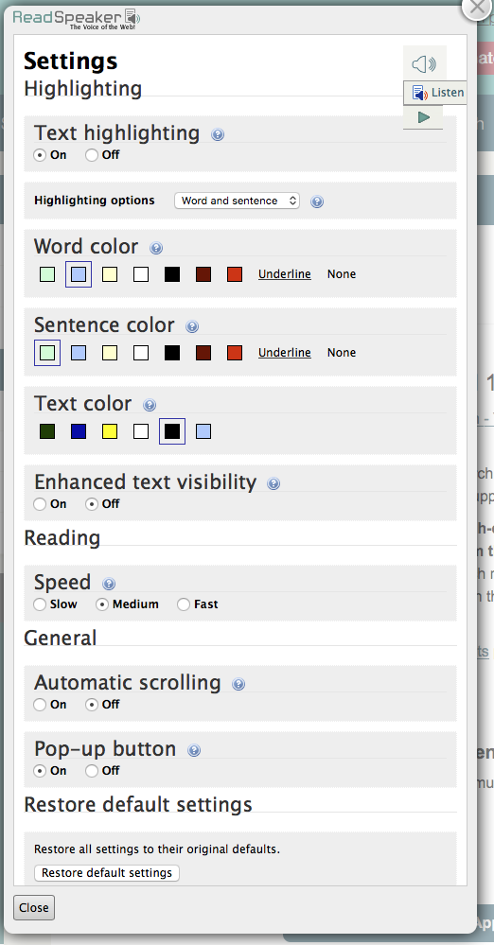
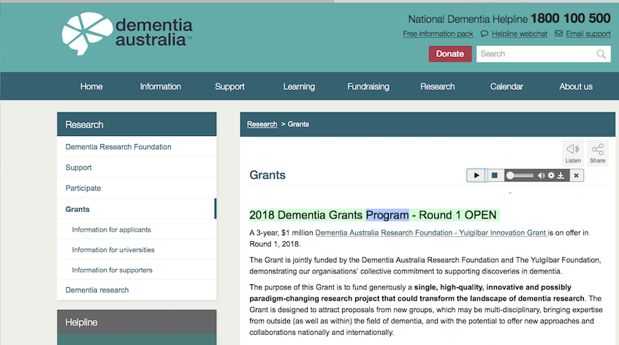
https://www.dementia.org.au/research/grants

Slide 64
Poor motor control
Small icons or landing zones make it harder to navigate
Increase icon size
Increase landing zone
E.g. human resource site
E.g. radio button in HTML4 and HTML5

Slide 65
Web Accessibility Standard
The W3C Web Accessibility Initiative (WAI) brings together people from industry, disability organizations, government, and research labs from around the world to develop guidelines and resources to help make the Web accessible to people with auditory, cognitive, neurological, physical, speech, and visual disabilities.

Slide 66
Web Content Accessibility Guidelines
Four principles of the WCA (WCAG 2.0)
Perceivable
Operable
Understandable
Robust

Slide 67
Accessibility requirements
Web accessibility refers to the inclusive practice of removing barriers that prevent interaction with, or access to websites, by people with disabilities. When sites are correctly designed, developed and edited, all users have equal access to information and functionality

Slide 68
Accessibility - WCAG 2.0
Web Content Accessibility Guidelines
https://www.w3.org/WAI/intro/wcag

Slide 69
Evaluating Accessibility
Easy check
Page title,
image text alternatives,
headings, colour contrast,
resize text,
keyboard access and visual focus,
forms, labels, and errors,
Moving, flashing, or blinking content
Multimedia (video, audio) alternatives
Basic structure check
https://www.w3.org/WAI/eval/preliminary#media

Slide 70
Accessibility
Used to validate URLs
https://validator.w3.org

Slide 71
Thank you
Any Questions

